Slide 1


Fault-Tolerant Distributed File System (NeoFS)
Reliable • Scalable • Self-Healing Storage
Presented by: Vivek Singh(12402642) & Divanshi Garg (12403691) for the Operating Systems course

Slide 2





Introduction to Distributed File Systems
Decentralized Data Storage
Enhanced Availability
A Distributed File System (DFS) stores data across multiple interconnected nodes, eliminating reliance on a single server.
By distributing data, DFS ensures high availability, meaning data remains accessible even if some nodes fail.
Scalability & Reliability
DFS inherently provides reliability and scalability, allowing systems to grow and adapt to increasing data demands.

Slide 3

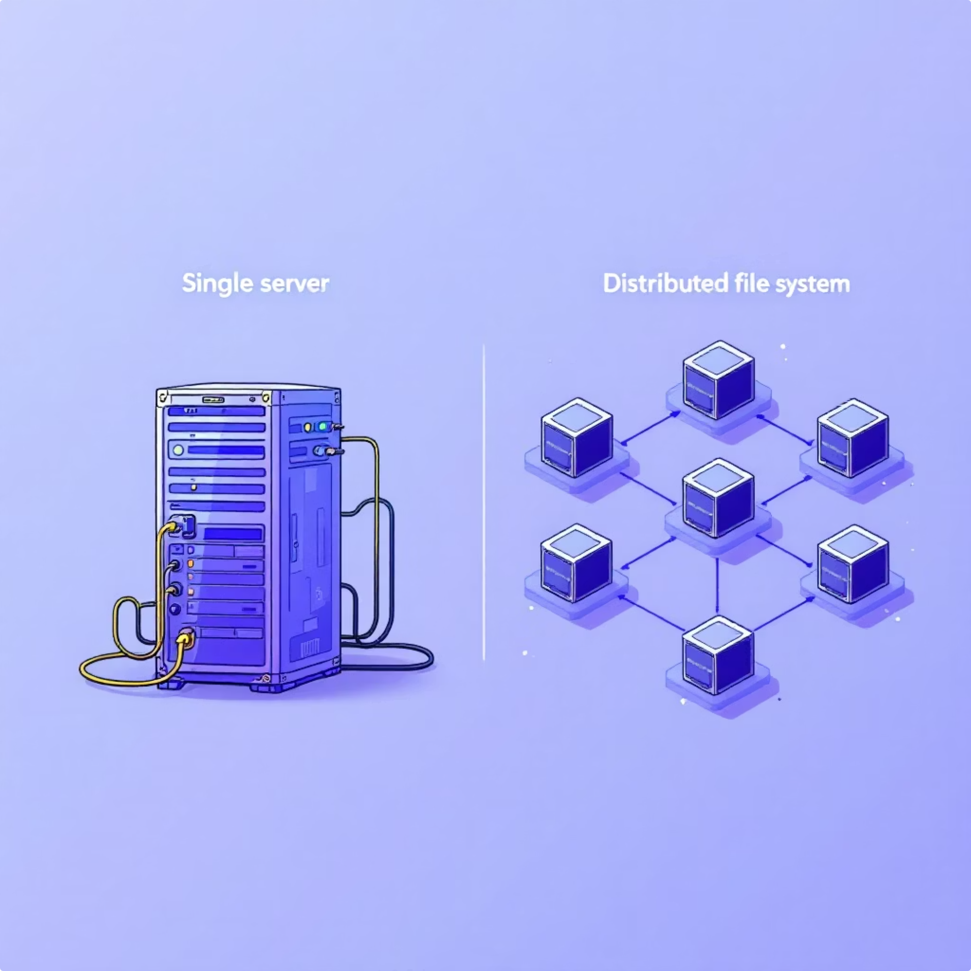



Problem Statement & Motivation
Single Point of Failure
Traditional centralized systems are vulnerable to a single point of failure, leading to catastrophic data loss and system downtime.
Vulnerability to Crashes
Existing file systems often cannot tolerate machine crashes, jeopardizing data integrity and continuous operation.
Need for Resilience
There is a critical need for a system that maintains continuous operation and data accessibility even when individual nodes fail.
Our key goal: Build a self-healing storage system using replication and automated recovery mechanisms.

Slide 4

NeoFS: System Architecture
Data Node
Stores blocks and serves requests
Master node
Replication
Manages metadata, assigns replicas, coordinates nodes
Replicate data among nodes
Monitoring
Master Server
Node Servers (5)
Client/GUI
Manages file metadata, assigns block replicas, and monitors the health and status of all connected node servers.
These distributed servers store actual data blocks and respond to client requests for fetching or storing information.
Provides user interface for data upload/download, node control, and real-time monitoring of the distributed file system.

Slide 5



How NeoFS Works: Block-Based Model
NeoFS optimizes storage and retrieval by breaking down files into manageable blocks and distributing them across the network.
File Segmentation
Each file is first split into uniform 64 KB data blocks to facilitate efficient handling and distribution.
Replication Strategy
Each block is replicated multiple times (number is configurable) to ensure redundancy and fault tolerance.
Distributed Storage
These blocks are then stored on different physical node servers, typically in dedicated directories like /storage/nodeX/.
Metadata Management
The Master Server meticulously maintains all file metadata, including the crucial mapping of blocks to their respective replicas and nodes.

Slide 6
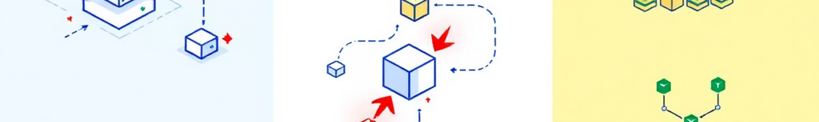
Fault Tolerance Workflow
NeoFS ensures continuous operation through a robust heartbeat and re-replication mechanism.
1
2
Heartbeat Monitoring
Failure Detection
All Node Servers transmit heartbeats to the Master Server every second, signaling their operational status.
The Master instantly detects when a node stops sending heartbeats, marking it as failed.
3
4
Block Re-Replication
Uninterrupted Operation
Upon detecting a failed node, the Master identifies missing blocks and automatically initiates their re-replication to healthy, available nodes.
This proactive recovery ensures that the system continues to operate seamlessly without any data loss or service interruption.

Slide 7
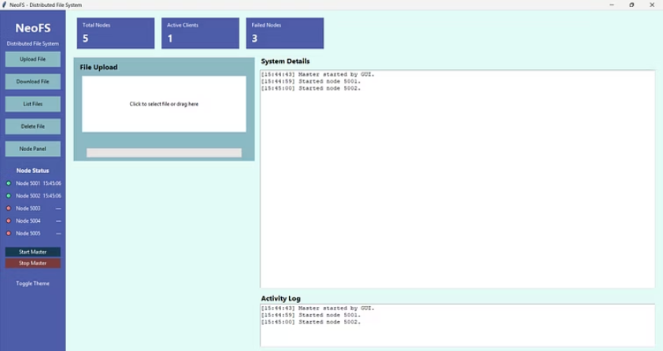
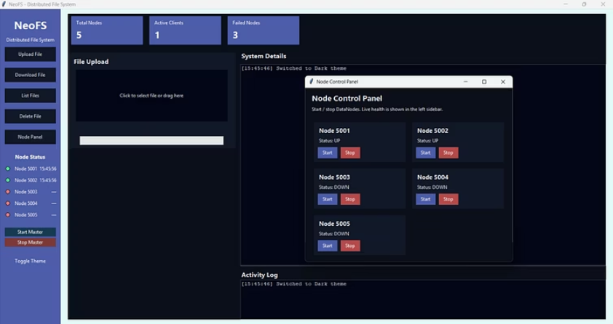
Key Features & GUI Highlights
Core System Features
Graphical User Interface (GUI)
Distributed File Storage
File Operations
Securely stores data across multiple nodes.
Intuitive upload, download, and delete functionalities.
Block-Level Replication
Node Status Indicators
Ensures data redundancy for fault tolerance.
Visual cues (green/red) for real-time node health.
Automatic Block Recovery
Node Control Panel
Self-healing mechanism to restore lost data.
Centralized management for starting, stopping, and configuring nodes.
Heartbeat Failure Detection
Customizable Theme
Real-time monitoring of node health.
Switch between light and dark themes for user comfort.
Scalable Node Architecture
Comprehensive Activity Logs
Easily expand storage capacity by adding nodes.
Detailed records of all system operations and events.

Slide 8
Conclusion & Future Scope
NeoFS is a fully functional distributed file system, successfully integrating block-level replication, robust node monitoring, and automated self-healing capabilities.
Future Enhancements
Data Encryption
Load Balancing
Multi-Master Architecture
Implementing robust encryption for data at rest and in transit.
Optimizing data distribution and request handling across nodes.
Enhancing fault tolerance and scalability of the control plane itself.
Web-Based Access
Cloud Deployment
Developing a web portal for remote access and management.
Containerizing NeoFS for seamless deployment on various cloud platforms.
Thank You — Questions Welcome!

